Slide 2
What is XGBoost? (eXtreme Gradient Boosting)
“The name XGBoost, though, actually refers to the engineering goal to push the limit of computations resources for boosted tree algorithms. Which is the reason why many people use xgboost.”— Tianqi Chen
XGBoost is a library for the implementation of gradient boosted decision trees designed for speed and performance created by Tianqi Chen

Slide 3
Tree-based Classifier
Decision Tree algorithms or CART (Classification and Regression Trees) are a very useful supervised learning method
High-accuracy, stability and interpretability
Can handle non-linear relationships well
Very compatible with ensemble learning methods
Ensemble learning methods: Use multiple learning algorithms to get better predictions

Slide 4
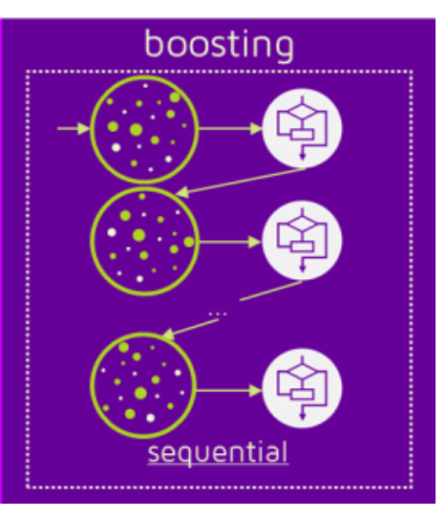
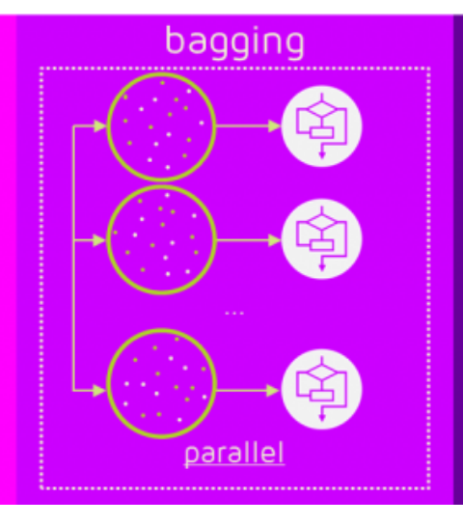
Decision Trees: Boosting vs. Bagging
Boosting and Bagging are two different approaches to generating classifiers for ensemble learning
For boosting algorithms, after a classifier is trained on the data, the weights of the observations it misclassified are increased
The next classifier is then trained on the observations with the weights adjusted based on the results of the prior classifier
XGBoost and Gradient Boosting are examples of Boosting
Random Forest is an example of bagging (Bootstrapping and Aggregating)
Source: quantdare

Slide 5
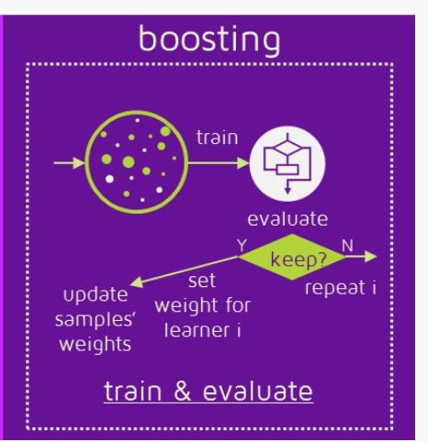
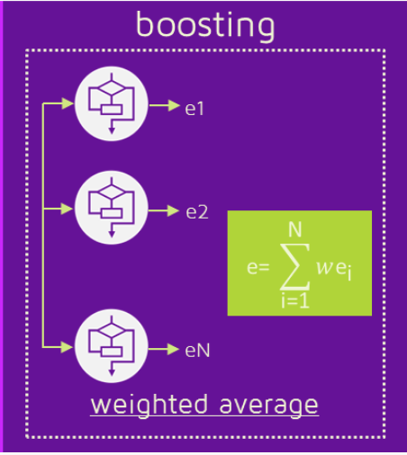
Boosting: Classification
Unlike Bagging which takes a simple average of its classifiers to make prediction, Boosting also generates classifier weights during the training stage which it uses to weight classifiers and make predictions
Source: quantdare

Slide 6
Gradient Boosting
There are different types of Boosting, (training multiple ”weak learners” sequentially to improve model predictions)
XGBoost uses Gradient Boosting but in the recent past other forms of Boosting such as AdaBoost (Adaptive Boosting) were popular
Gradient Boosting is a type of Boosting which uses gradient descent as its loss function
Rather than training the next classifier on a re-weighted set of observations as in AdaBoost, Gradient Descent takes the errors/residuals of the previous classifier and trains on that

Slide 7
Decision Trees: XGBoost vs. Random Forest
Gradient Boosting and Random Forest are both ensemble learning methods which use the outputs of many decision trees to make predictions
Gradient Boosting as a type of Boosting method, uses the errors made by previous tree to fit a new tree. Since the new predictor is fit to residuals from the previous tree, Gradient Boosting grows trees sequentially
Random Forest trains full decision trees on random samples of the data set. Using random samples and growing trees that are uncorrelated, Random Forest grows trees in parallel

Slide 8
An Improved Version of Gradient Boosting
Execution Speed. Generally, XGBoost is fast. Really fast when compared to other implementations of gradient boosting.
Model Performance. Benchmark
XGBoost is frequently used in high-ranking Kaggle submissions

Slide 9
How does XGBoost Improve on Gradient Boosting?
System Optimization
Parallelization
Tree Pruning
Hardware Optimization
Algorithmic Improvements
Regularization
Sparsity Awareness
Weighted Quantile Sketch Algorithm

Slide 10
Advantages of XGBoost for LendingClub Data
Because the loans we wanted to avoid made up a relatively small % of the overall loans our data was imbalanced
Gradient Boosting and by extension XGBoost is often a good fit for unbalanced data and anomaly detection

